Slide 1
Entity Relationship Extraction

Slide 2
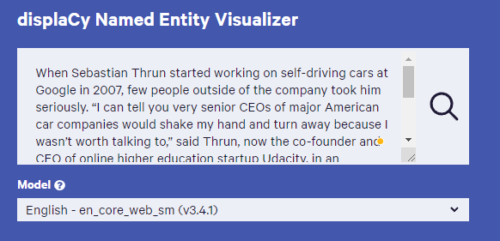
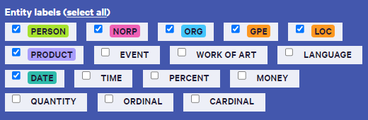
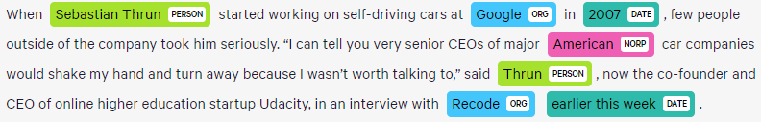

NER Definition
Named entity recognition (NER) (also known as entity identification (EI) and entity extraction) is the task that locate and classify atomic elements in text into predefined categories such as the names of persons, organizations, locations, expressions of times, quantities, monetary values, percentages, etc.

Slide 3
Why NER is Hard?
Ambiguity:
1945 (date vs. time)
Washington (location vs. person)
May (person vs. month)
Tata (person vs. organization)
Person vs Location
Sir C. P Ramaswamy was the Divan of Travancore (Per)
Sir C.P Ramaswamy Road is in Chennai (Loc)
Person vs Organization
Anil Ambani opened Reliance Fresh (Per)
Reliance Fresh is under Anil Amabani Group Ltd (Org)
Definition
Hotel & Taj Hotel
Flower & Rose Flower
Beach & Kovalam Beach
Airport & Indira Gandhi International airport
The School & Good Shepherd School
Prime Minister & Mr. Manmohan Singh
Style, structure, domain, genre etc.
Punctuation, spelling, spacing, formatting, ….all have an impact
Dept. of Computing and Information Science
Manchester Metropolitan University
Manchester
United Kingdom
The Modi Government
> Tell me more about Leonardo
> Da Vinci
Variation
Manmohan Singh, Manmohan, Dr. Manmohan Singh

Slide 4
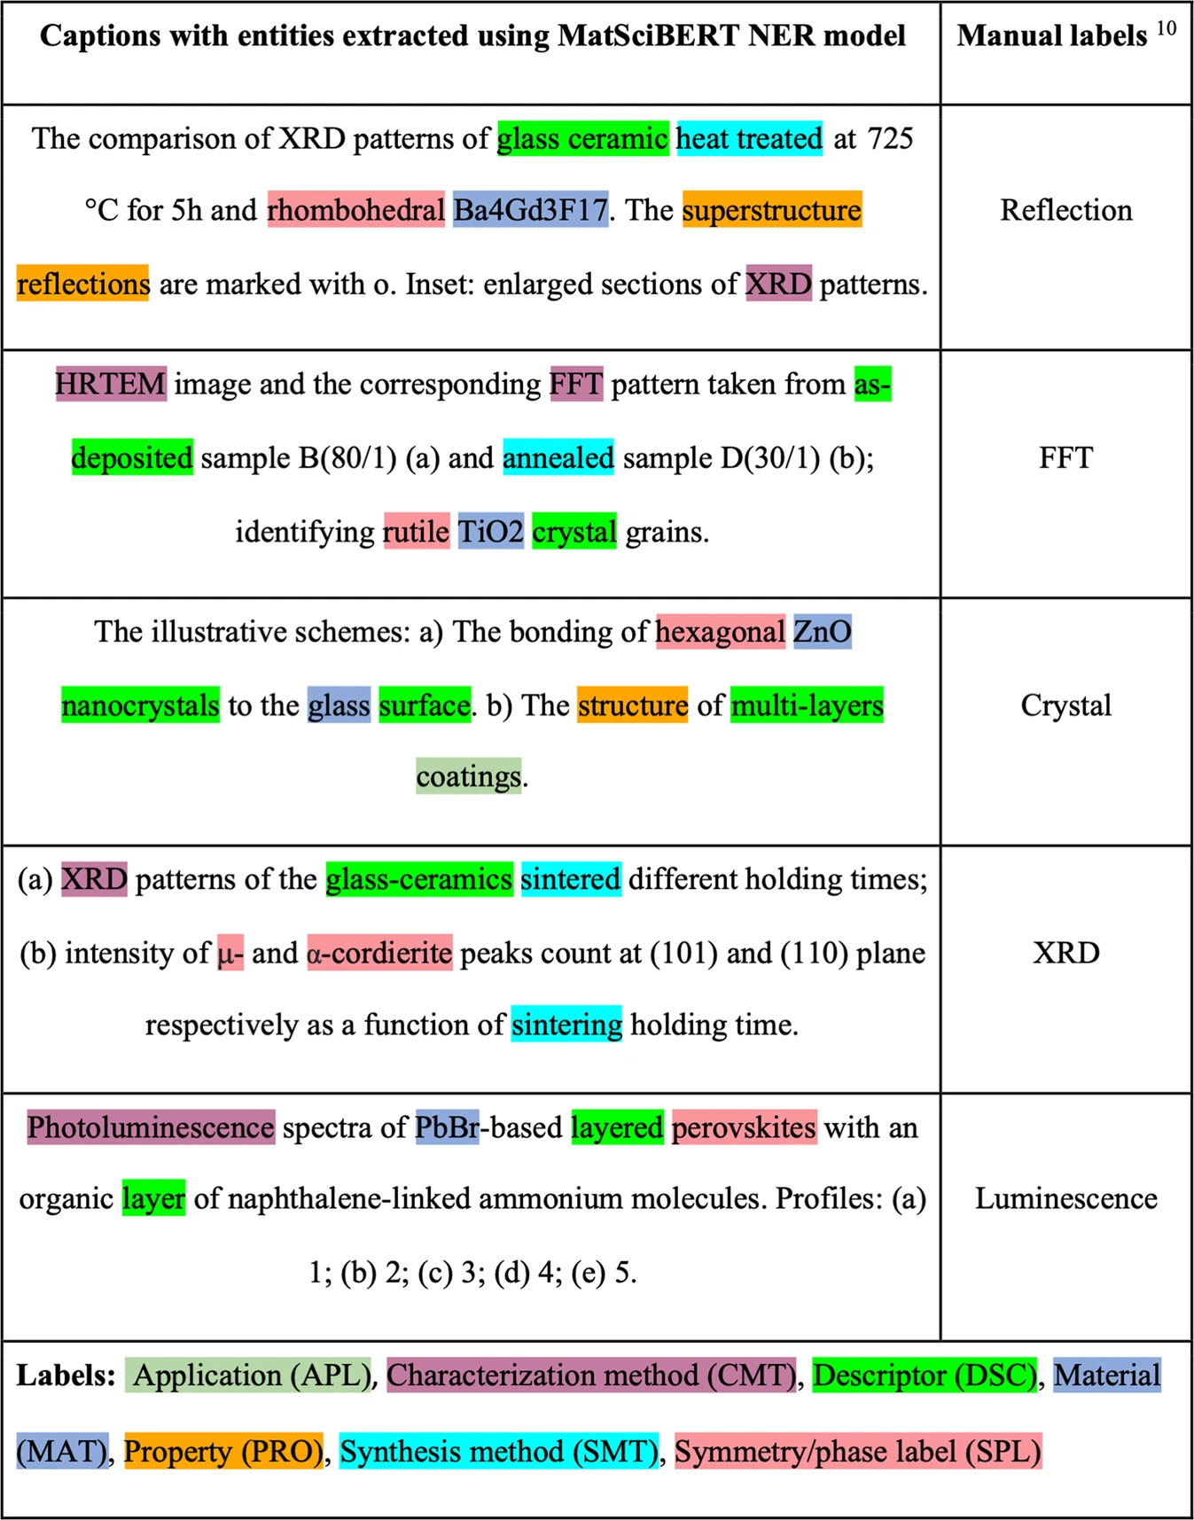
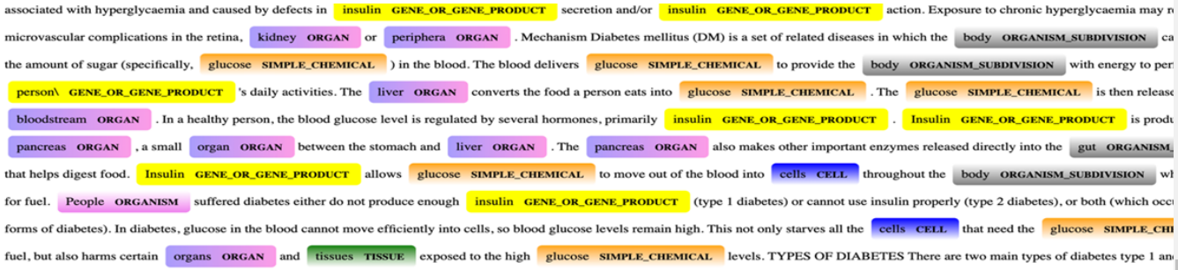
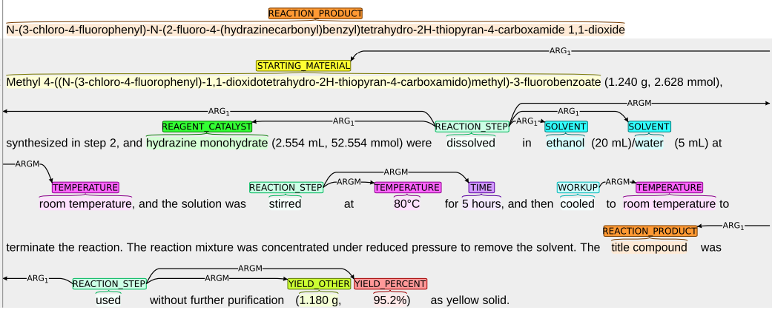
NER for different Domains

Slide 5
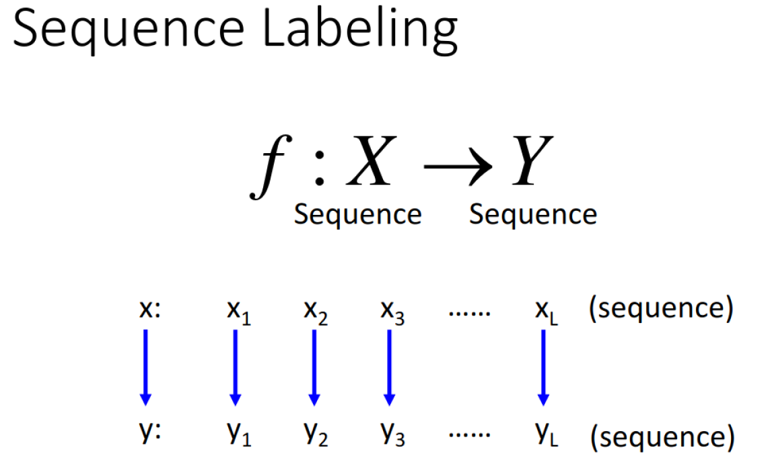
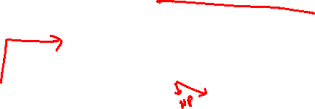
Building your own NER
O what O movies O star O bruce\ACTOR willis \ACTOR
O show O mestar O films O with drew \ACTOR barrymore\ACTOR O from O the 1980s \YEAR
O find O me O all O of O the O movies O that O starred harold\ACTOR ramis \ACTOR O and bill\ACTOR murray \ACTOR
O find O me O a O movie O with O a O quote O about O baseball O in O it
O what O movies O have mississippi\TITLE O in O the O title

Slide 6
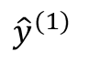
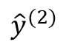
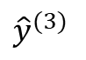
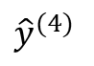
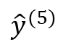




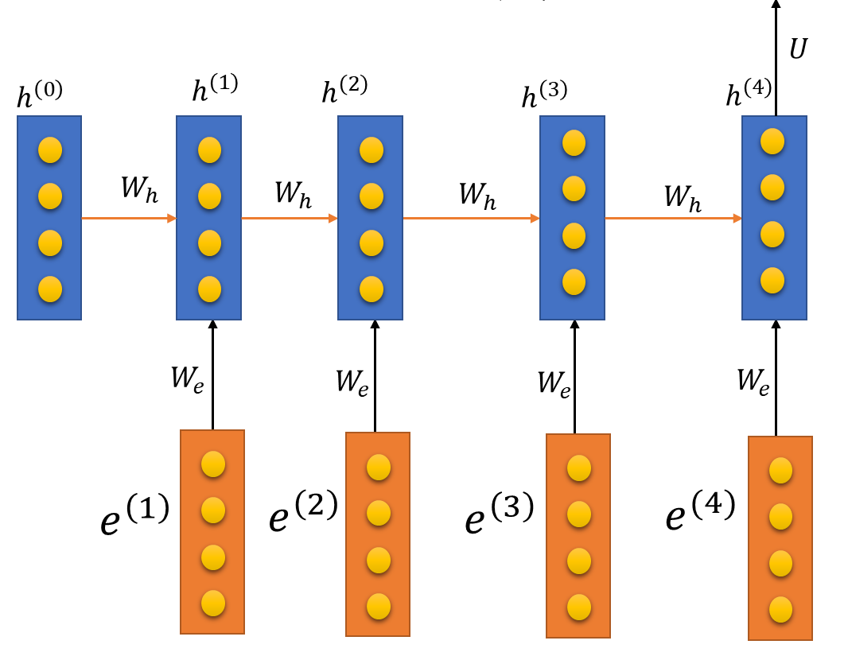
Bi-LSTM model for NER
PN o o o FN
The best time to visit is during May when you can see both the red Rhododendrons as well as the snow, it is also considered as a holy month.
John Hopkins University
Dense
Dense
Dense
Dense
Dropout
Dropout
Dropout
Dropout
…
…
Rose rose to put rows of roses.

Slide 7
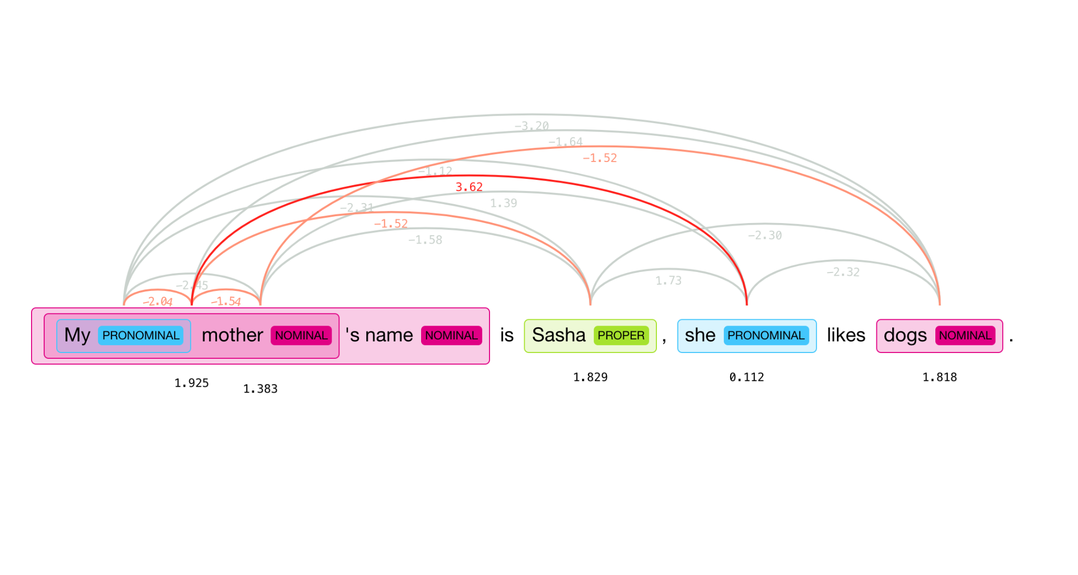
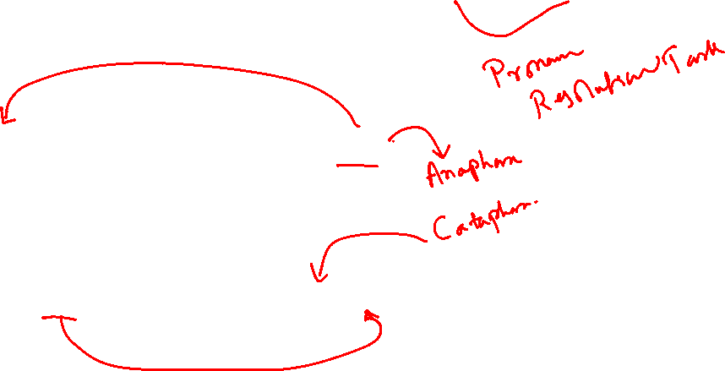
Entity Resolution - Spacy Neural Co-Ref
Sally arrived, but nobody saw her
Before her arrival, nobody saw Sally

Slide 8
Reference Resolution
Discourse Model
It contains representations of the entities that have been referred to in the discourse and the relationships in which they participate.
Two components required by a system to produce and interpret referring expressions.
A method for constructing a discourse model that evolves dynamically.
A method for mapping between referring expressions and referents.

Slide 9
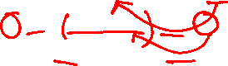
Reference Phenomena
Five common types of referring expression
Type | Example
Indefinite noun phrase | I saw a Ford Escort today.
Definite noun phrase | I saw a Ford Escort today. The Escort was white.
Pronoun | I saw a Ford Escort today. It was white.
Demonstratives | I like this better than that.
One-anaphora | I saw 6 Ford Escort today. Now I want one.
Three types of referring expression that complicate the reference resolution
Type | Example
Inferrables | I almost bought a Ford Escort, but a door had a dent.
Discontinuous Sets | John and Mary love their Escorts. They often drive them.
Generics | I saw 6 Ford Escorts today. They are the coolest cars.

Slide 10
Reference Resolution
How to develop successful algorithms for reference resolution? There are two necessary steps.
First is to filter the set of possible referents by certain hard-and-fast constraints.
Second is to set the preference for possible referents.

Slide 11
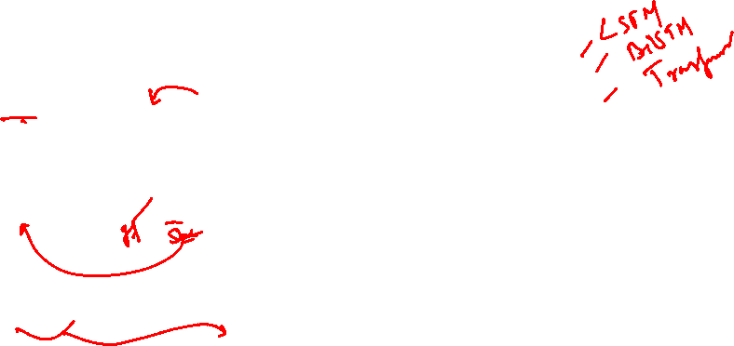
Constraints (for English)
Number Agreement:
To distinguish between singular and plural references.
*John have new cars. They are red.
Gender Agreement:
To distinguish male, female, and non-personal genders.
John has a new car. It is attractive. [It = the new car]
Person and Case Agreement:
To distinguish between three forms of person;
*You and I have Escorts. We love them.
To distinguish between subject position, object position, and genitive position.
Selectional Restrictions:
A verb places restrictions on its arguments.
John parked his Acura in the garage. He had driven it around for hours. [it=Acura, it≠garage];
I picked up the book and sat in a chair. It broke.

Slide 12
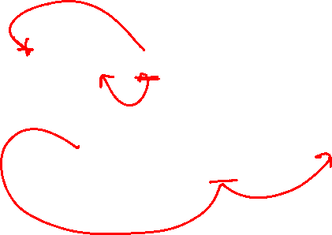
Syntax can’t be all there is
John hit Bill. He was severely injured.
Margaret Thatcher admires Hillary Clinton, and George W. Bush absolutely worships her.

Slide 13
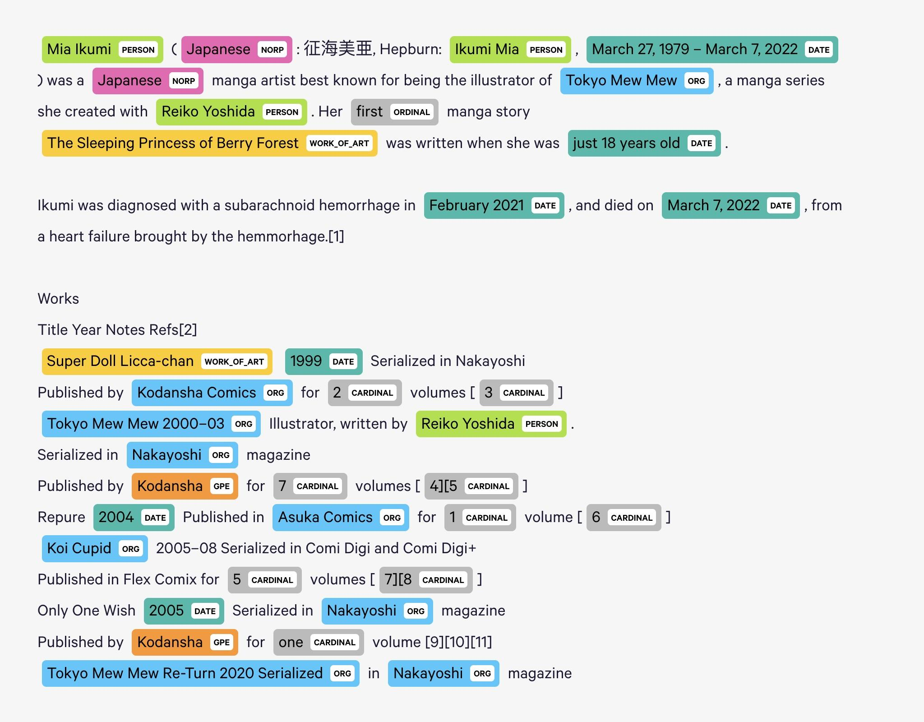
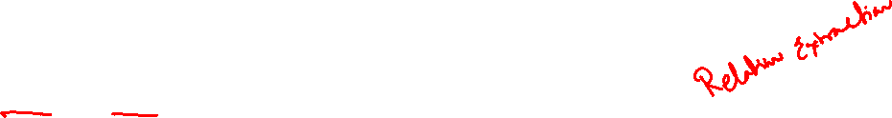
How to obtain facts from entities?
How to relate specific types of entities to obtain world knowledge?
<Mia Ikumi is a Person>
<Mia Ikumi Nationality Japanese>
<Mia Ikumi was_born_in 27 Mar, 1979>
<Mia Ikumi died_in 2022>
<Mia Ikumi created Koi Cupid>
<Mia Ikumi suffered_from subarachnoid hemorrhage>

Slide 14
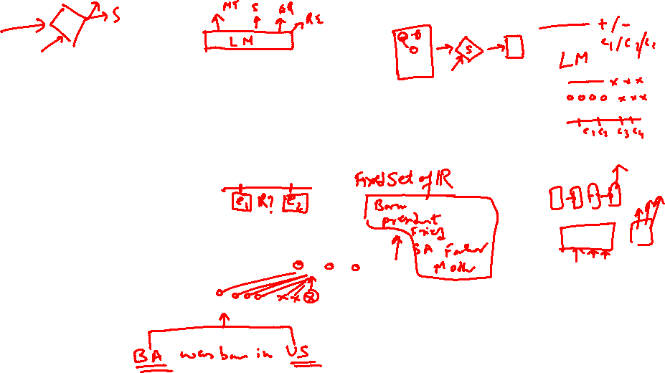
Relation Extraction Methods
Supervised Methods - Look for known relations among entities of known types
<Person born_in date>
<Person nationality Location>
Semi-Supervised Methods -
Role of Freebase, DbPedia or any other Knowledge Base which defines the expected entity types and relations.
Unsupervised Methods - Look for relations between two entities
<Entity 1 - Subject, Predicate, Object - Entity 2>

Slide 15
Supervised Relation Extraction
For each pair of entities in a sentence, predict the relation type (if any) that holds between them.
The supervised approach requires:
Defining an inventory of relation types
Collecting labeled training data (the hard part!)
Designing a feature representation
Choosing a classifier: SVM, RNN, CNN, Transformers…
Evaluating the results
Features:
Bags of words & bigrams between, before, and after the entities
Stemmed versions of the same
The types of the entities
The distance (number of words) between the entities
phrase chunks
Dependency-tree paths
Tree distance between the entities
Presence of particular constructions in a constituent structure
etc.

Slide 16
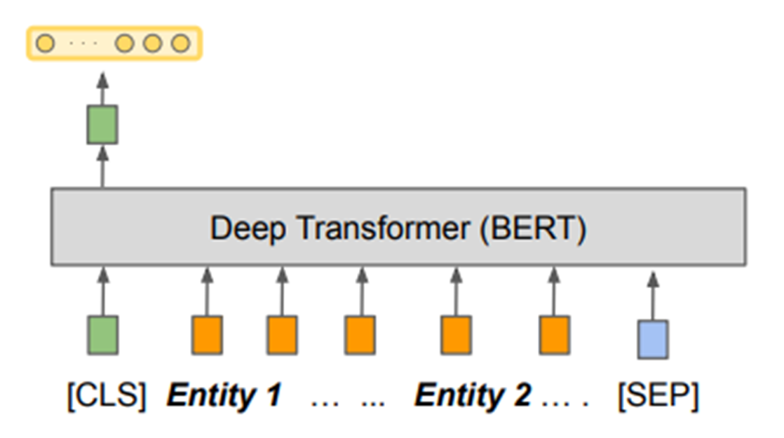
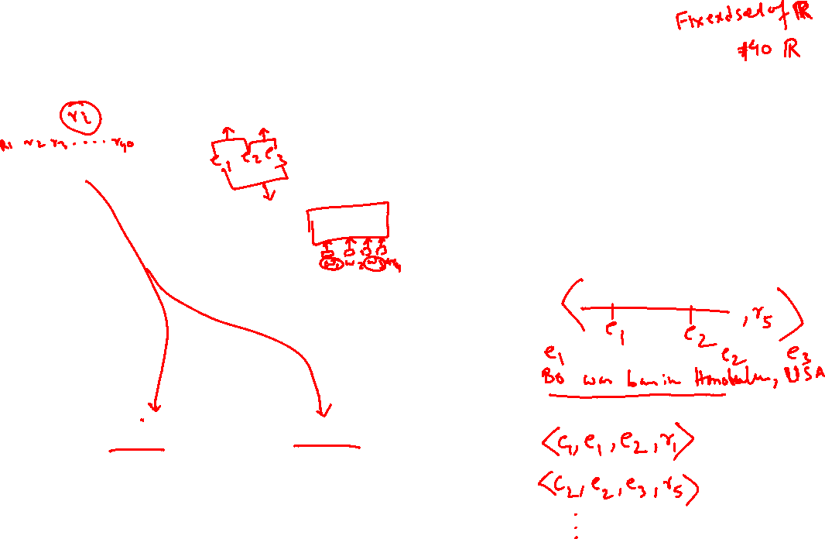
Supervised Relation Extraction
Issues: Unable to handle multiple entities with multiple relations

Slide 17
Architectures for relational learning using BERT
Two key questions have to be answered:
How can the entities of interest be presented to the model?
How can one extract a fixed-length relation representation from BERT’s output?
Barack Obama was born in Honolulu, Hawaii.

Slide 18
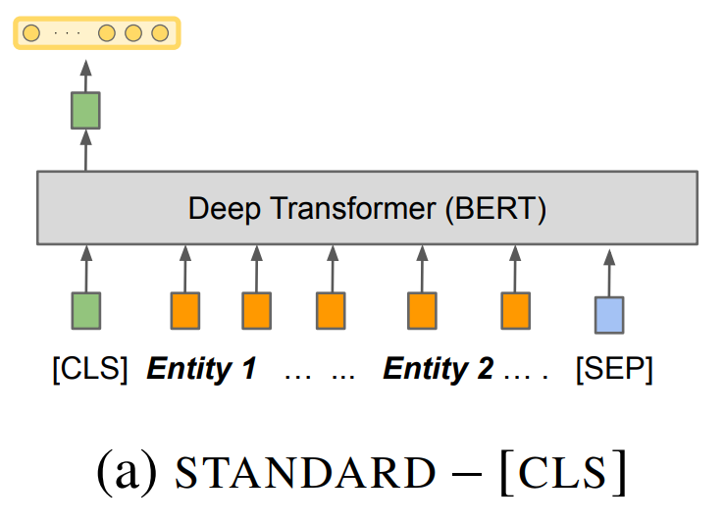
How can the entities of interest be presented to the model?
The easiest way is to apply the ostrich strategy and completely ignore it. This however raises problems in longer sentences with multiple entities as the model does not know about the entity combination for which it should extract the relation.

Slide 19
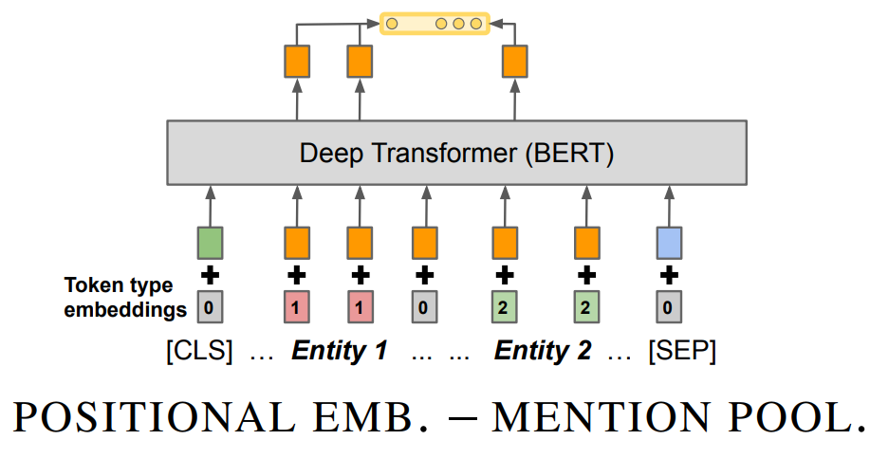
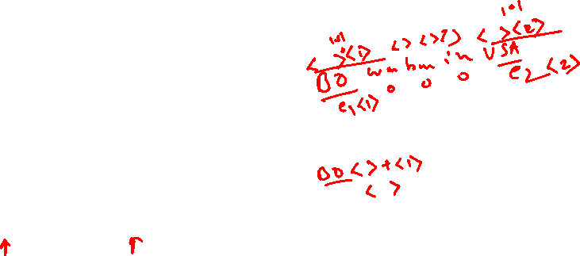
How can the entities of interest be presented to the model?
The second approach is passing positional embeddings for each word in the sentence that serve as entity markers.

Slide 20
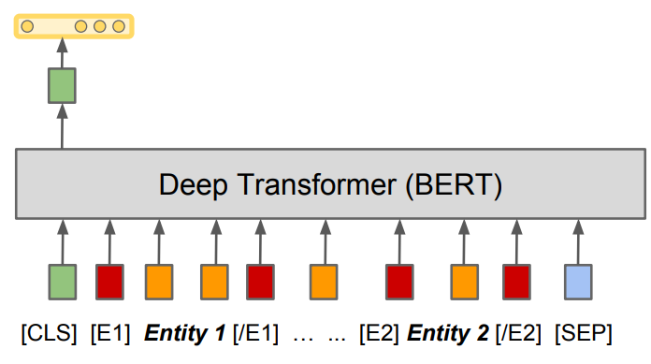
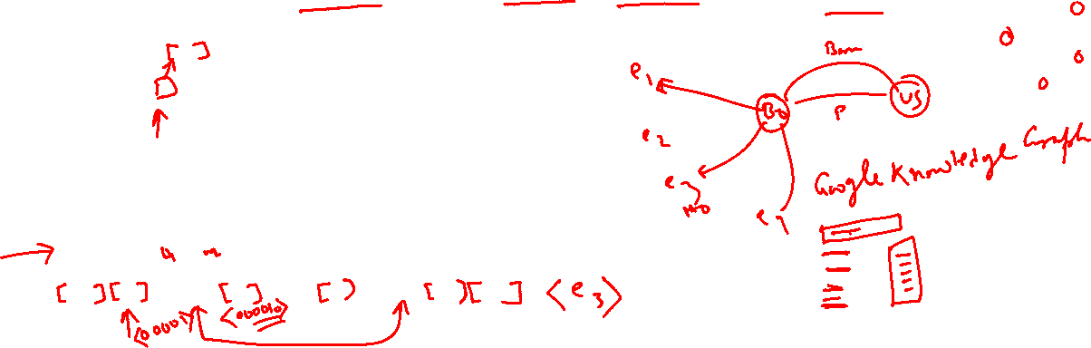
How can the entities of interest be presented to the model?
The final and best working approach is to wrap the entities of interest in entity marker icons so that the final sequence would look like this.

Slide 21
Semi-Supervised approaches: Hand-built patterns
Intuition from Hearst (1992)
Agar is a substance prepared from a mixture of red algae, such as Gelidium, for laboratory or industrial use.
What does Gelidium mean?
How do you know?
Requires hand-building patterns for each relation!
hard to write;
hard to maintain
there are zillions of them
domain-dependent
Don’t want to do this for all possible relations!
lexico-syntactic patterns
Ys such as X ((, X)* (, and/or) X)
such Ys as X…
X… or other Ys
X… and other Ys
Ys including X…
Ys, especially X…
Hearst, 1992. Automatic Acquisition of Hyponyms.

Slide 22
Semi-Supervised approaches
If you don’t have enough annotated text to train on …
But you do have:
some seed instances of the relation
(or some patterns that work pretty well)
and lots & lots of unannotated text (e.g., the web)
we use existing relational triples to automatically identify extraction examples in a large corpus.
For example,
if we already have in our KB the relational triple (founders, SpaceX, Elon_Musk),
we can search a large corpus for sentences in which "SpaceX" and "Elon Musk" co-occur,
make the (unreliable!) assumption that all the sentences express the founder relation, and then use them as training data for a learned model to identify new instances of the founder relation

Slide 23
Key Intuition
Distributional Similarity, applied to relations
“...if two entities participates in a relation, any sentence that contain those two entities is more likely to express that relation” [Mintz et al., 2009]

Slide 24
Bootstrapping/Semi-Supervised approaches
This is a powerful idea, but has limitations.
The first is that, inevitably, some of the sentences in which "SpaceX" and "Elon Musk" co-occur will not express the founder relation
"Billionaire entrepreneur Elon Musk announced the latest addition to the SpaceX arsenal: the 'Big F---ing Rocket' (BFR)".
Injecting noise into our training data, and making it harder for our learning algorithms to learn good models.
Still effective: because it makes it possible to leverage vastly greater quantities of training data, and the benefit of more data outweighs the harm of noisier data.
We need an existing KB to start from!
We can only train a model to extract new instances of the founders relation if we already have many instances of the founders relation.
Notes:
By making the blind assumption that all such sentences do express the founder relation, we are essentially injecting noise into our training data, and making it harder for our learning algorithms to learn good models. Distant supervision is effective in spite of this problem because it makes it possible to leverage vastly greater quantities of training data, and the benefit of more data outweighs the harm of noisier data.
The second limitation is that we need an existing KB to start from. We can only train a model to extract new instances of the founders relation if we already have many instances of the founders relation. Thus, while distant supervision is a great way to extend an existing KB, it's not useful for creating a KB containing new relations from scratch.

Slide 25
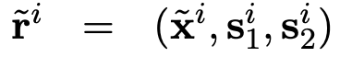
Matching the Blanks: Distributional Similarity for Relation Learning https://arxiv.org/pdf/1906.03158.pdf
The focus is to learn mappings from natural language relation statements to relation representations.
Formally, let x=[x₀ …xₙ] be a sequence of tokens, where x₀=[CLS] and xₙ=[SEP] are special start and end markers.
Let s₁=(i, j) and s₂=(k, l) be pairs of integers such that 0 < i < j−1, j < k, k ≤ l−1 and l ≤ n.
A relation statement is a triplet r=(x, s₁, s₂), where the indices in s₁ and s₂ delimit entity mentions in x:
the sequence [xᵢ …xⱼ₋₁] mentions an entity, and so does the sequence [xₖ …xₗ-₁].
Barack Obama, the 44th president of the United States
Barack Obama was born in Honolulu, Hawaii.
The goal is to learn a function hᵣ=fθ(r) that maps the relation statement to a fixed-length vector hᵣ ∈ ℝᵈ that represents the relationship expressed in x between the entities marked by s₁ and s₂.
(airlift, alleviates, hunger crisis) (hunger crisis, is eased by, airlift) (airlift, helps resolve, hunger crisis) (airlift, addresses, hunger crisis)

Slide 26
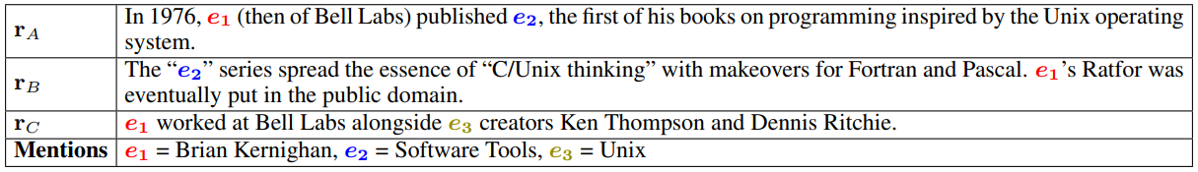
Example of “matching the blanks” automatically generated training data

Slide 27
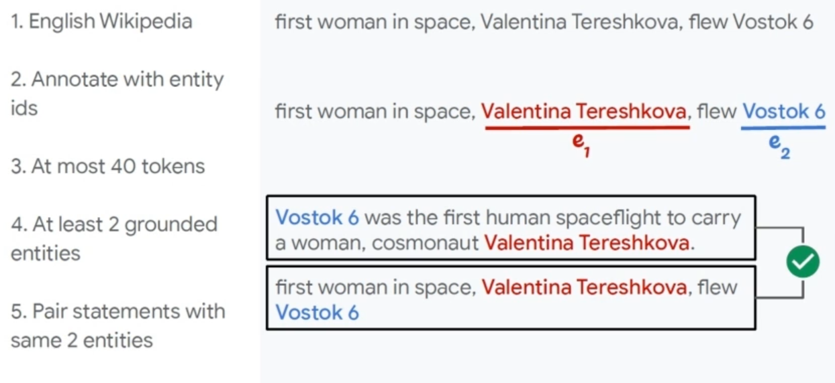
Training

Slide 28
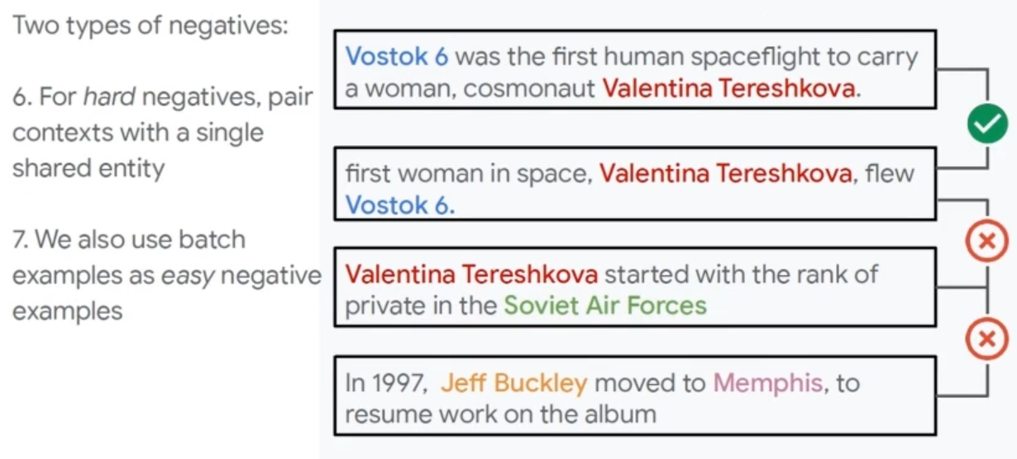
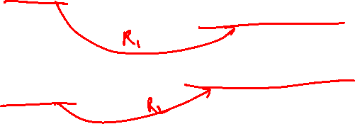
Training

Slide 29
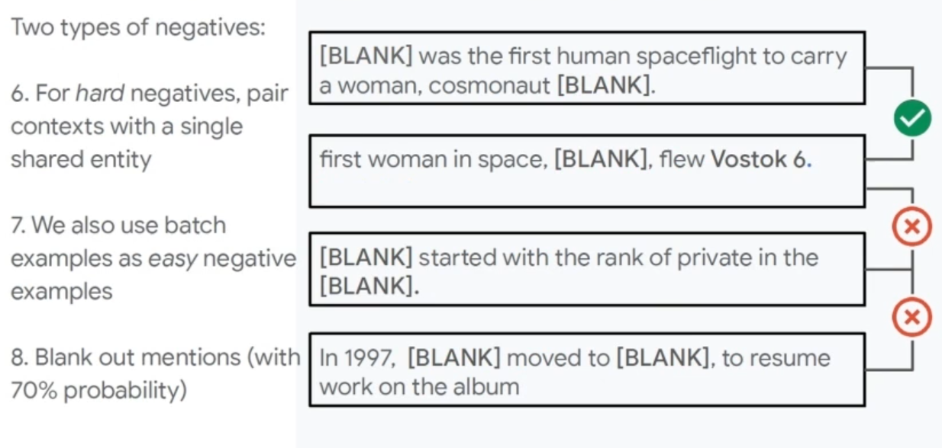


Training

Slide 30
Need to handle more complexities
Long sentences, clauses, spread across sentences, multiple relations in a sentence
A woman of 80 years , on long - term warfarin therapy presented with an acute dissecting thoracic aortic aneurysm ; on investigation the only precipitating factor found was an international normalised ratio of 4.8 .
The risk / benefit ratio of warfarin therapy changes in the over 75s , when haemorrhagic side - effects become more common.
In view of our experience in the present case , it should be stressed that close monitoring of coagulation capacity is necessary in critically ill patients in order to avoid fatal haemorrhage after initiating warfarin therapy regardless of the dosage .
A man of 60 years suffering from thrombisis was administered with warfarin and he responded immediately.
Can we use more information about structures - not just flat semantics of the sentence

Slide 31
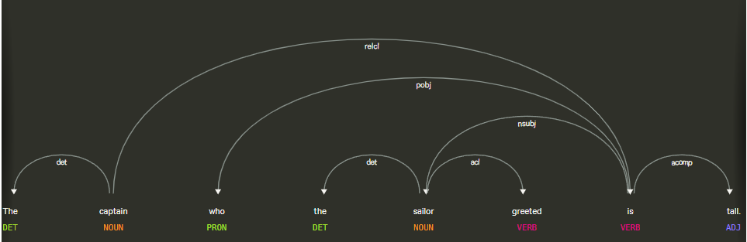
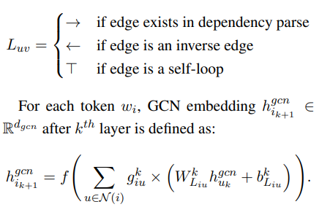
GCN on Labeled Directed Graph
For a given sentence, we generate its dependency tree using Stanford CoreNLP.
Can we use Graph networks? → GCN over the dependency graph

Slide 32
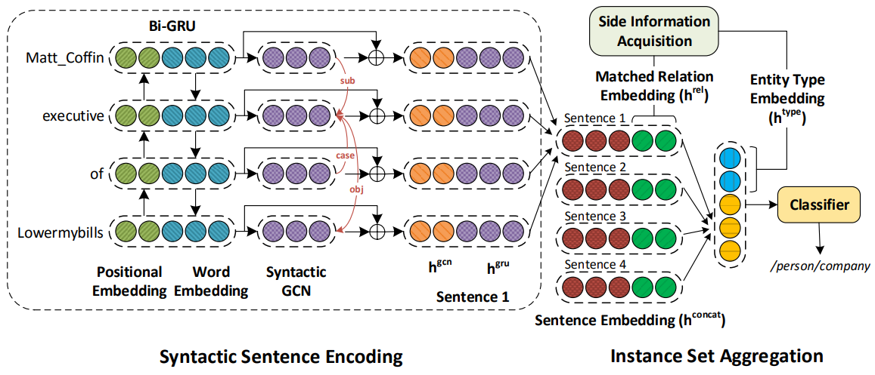
RESIDE: Improving Distantly-Supervised Neural Relation Extraction using Side Information
https://aclanthology.org/D18-1157/

Slide 33
Unsupervised Approaches
2005: KnowItAll
Generalizes Hearst patterns to other relations
Requires zillions of search queries; very slow
2007: TextRunner
No predefined relations; highly scalable; imprecise
2011: ReVerb
Improves precision using simple heuristics
2012: Ollie
2013: OpenIE 4.0 (Stanford)

Slide 34
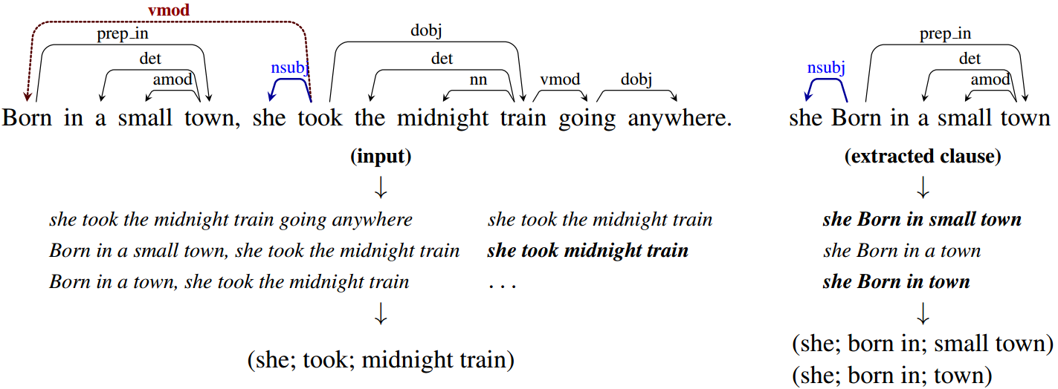
Stanford OpenIE: Key Components
Assertedness:
splits each sentence into a set of entailed clauses.
Minimal Proposition
Each clause is then maximally shortened, producing a set of entailed shorter sentence fragments.
Completedness
These fragments are then segmented into OpenIE triples, and output by the system.

Slide 35
Relation Extraction as Natural Language Inference Task
NLI is the task of determining the inference relationship between two sentences as Entailment, Contradiction and Neutral
A soccer game with multiple males playing
Entails
After taking Paracetamol, experienced Nausea
Some men are playing a sport
Entails
Contradicts
<DRUG> cures <CONDITION>
<CONDITION> is cured by <DRUG>
<DRUG> treats <CONDITION>
<DRUG> causes <CONDITION>
<CONDITION> is side-effect of <DRUG>

Slide 36
Relation Extraction
Using Deep Learning

Slide 37
Relation Extraction task
Relation Extraction is the task of predicting attributes and relations for entities in a sentence
Barack Obama was born in Honolulu, Hawaii.
predict each relation - r
(Barack Obama, r1, Honolulu)
(Barack Obama, r2, Hawaii)
(Honolulu, r3, Hawaii)Hawaii)
Ideally - what should be predicted
r1 = was born in
r2 = was born in
r3 = is in

Slide 38
Matching the Blanks: Distributional Similarity for Relation Learning https://arxiv.org/pdf/1906.03158.pdf
The focus is to learn mappings from natural language relation statements to relation representations.
Formally, let x=[x₀ …xₙ] be a sequence of tokens, where x₀=[CLS] and xₙ=[SEP] are special start and end markers.
Let s₁=(i, j) and s₂=(k, l) be pairs of integers such that 0 < i < j−1, j < k, k ≤ l−1 and l ≤ n.
A relation statement is a triplet r=(x, s₁, s₂), where the indices in s₁ and s₂ delimit entity mentions in x:
the sequence [xᵢ …xⱼ₋₁] mentions an entity, and so does the sequence [xₖ …xₗ-₁].
$x_{0}{ x}_{1}$ ${ x}_{2}$ $x_{3}$ $x_{4}$ $x_{5}$ ${ x}_{6}$ ${ x}_{7}$ ${ x}_{8}$ $x_{9} {… x}_{n}$

Slide 39
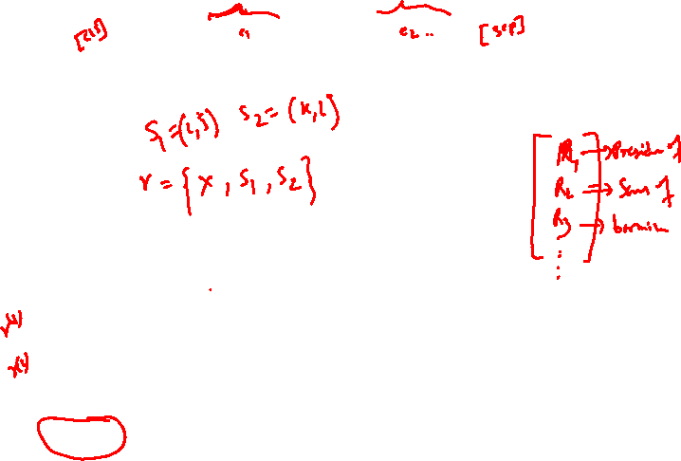
Matching the Blanks: Distributional Similarity for Relation Learning https://arxiv.org/pdf/1906.03158.pdf
The focus is to learn mappings from natural language relation statements to relation representations.
Formally, let x=[x₀ …xₙ] be a sequence of tokens, where x₀=[CLS] and xₙ=[SEP] are special start and end markers.
Let s₁=(i, j) and s₂=(k, l) be pairs of integers such that 0 < i < j−1, j < k, k ≤ l−1 and l ≤ n.
A relation statement is a triplet r=(x, s₁, s₂), where the indices in s₁ and s₂ delimit entity mentions in x:
the sequence [xᵢ …xⱼ₋₁] mentions an entity, and so does the sequence [xₖ …xₗ-₁].
$x_{0}{ x}_{1}$ ${ x}_{2}$ $x_{3}$ $x_{4}$ $x_{5}$ ${ x}_{6}$ ${ x}_{7}$ ${ x}_{8}$ $x_{9} {… x}_{n}$
Barack Obama, the 44th president of the United States
Barack Obama was born in Honolulu, Hawaii.
The goal is to learn a function hᵣ=fθ(r) that maps the relation statement to a fixed-length vector hᵣ ∈ ℝᵈ that represents the relationship expressed in x between the entities marked by s₁ and s₂.

Slide 40
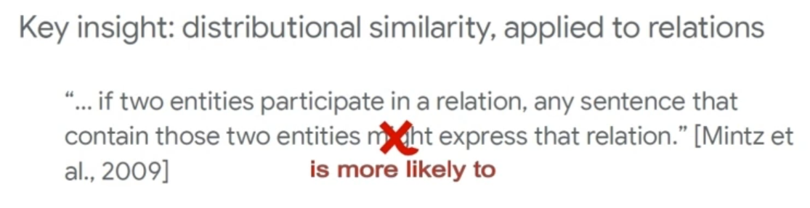
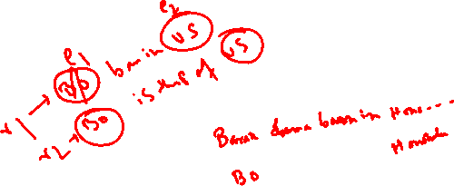
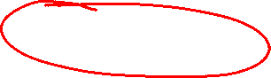
Key Intuition

Slide 41
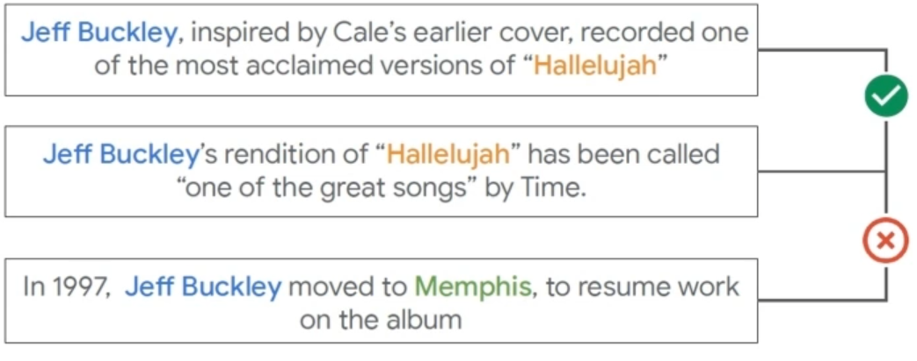
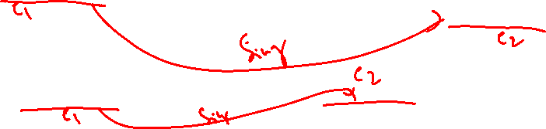

Slide 42
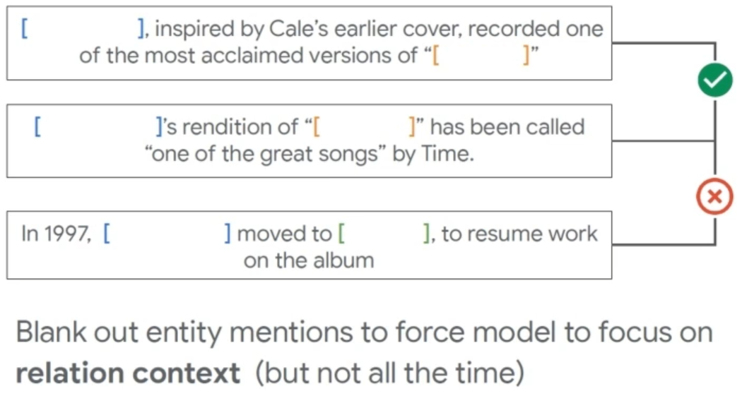
Key Intuition

Slide 43
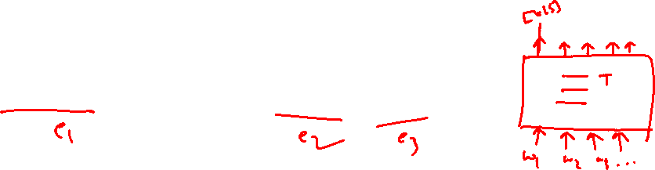
Architectures for relational learning using BERT
Two key questions have to be answered:
How can the entities of interest be presented to the model?
How can one extract a fixed-length relation representation from BERT’s output?
Barack Obama was born in Honolulu, Hawaii.

Slide 44
How can the entities of interest be presented to the model?
The easiest way is to apply the ostrich strategy and completely ignore it. This however raises problems in longer sentences with multiple entities as the model does not know about the entity combination for which it should extract the relation.

Slide 45

How can the entities of interest be presented to the model?
The second approach is passing positional embeddings for each word in the sentence that serve as entity markers.

Slide 46
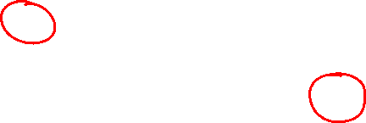
Position Embedding
Why Position Embedding matters?
Even though she did not win the match, she was satisfied
Even though she did win the match, she was not satisfied

Slide 47
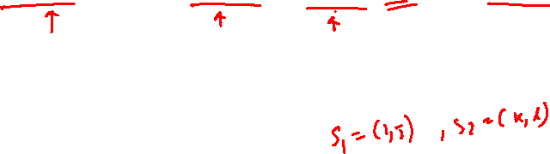
How can the entities of interest be presented to the model?
The final and best working approach is to wrap the entities of interest in entity marker icons so that the final sequence would look like this.

Slide 48
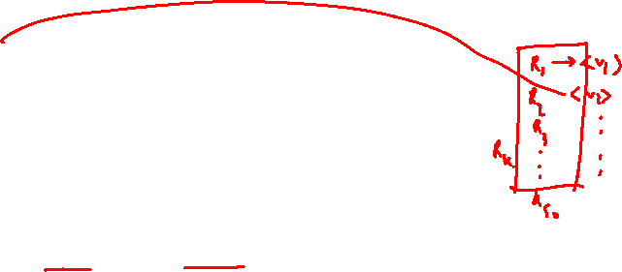
How to extract a fixed-length relation representation:
The first approach is fairly simple using the [CLS] token of BERT and adopt its embedding output h₀ as relation representation.

Slide 49


How to extract a fixed-length relation representation:
The second approach is to obtain the entity relation representation hᵣ by max pooling the final hidden layers corresponding to the tokens in each entity mention to get two embeddings hₑ₁=MAXPOOL([hᵢ…hⱼ₋₁]) and hₑ₂=MAXPOOL([hₖ…hₗ₋₁]) which will then be concatenated to form the final relation representation hᵣ.

Slide 50


How to extract a fixed-length relation representation:
Finally, the authors propose an approach they refer to as Entity Start State.
The approach is pretty straightforward, it just concatenates the final hidden states of the Entity start tokens E1ₛ and E2ₛ.
Note: this approach can only be applied if one uses the entity markers to solve the first problem. The image below depicts the different approaches of defining an architecture that is able to learn relation representations of two entities given a sequential input.

Slide 51


Illustration of losses used in our models
The left figure depicts a model suitable for supervised training, where the model is expected to classify over a predefined dictionary of relation types. The figure on the right depicts a pairwise similarity loss used for few-shot classification task.

Slide 52

Introducing Blanks
We’re able to train a relation extractor on pre-labeled data.
However, finding a labeled dataset that has the necessary size is hard, so we need to find a way to train the model on an unlabeled dataset.
To get to that point one has to make a few assumptions:
For any pair of relation statement r and t, the inner product fθ(r) fθ(t ) should be high if r and t express semantically similar relation statements and low otherwise.

Slide 53


Introducing Blanks
Given those assumptions, the authors aim to learn a statement encoder fθ that can be used to determine whether or not two relation statements encode the same relation. To do that they define the following binary classifier
to assign a probability to the case that r and r̂ encode the same relation (l=1) or not.

Slide 54
Introducing Blanks
As a neural network would be able to minimize that loss by just learning an entity linking model and not the actual relation between those entities we have to actively prevent it from doing so by introducing a special [BLANK] symbol and use this to mask the first entities s₁, u₁ by a given probability α and the second entities s₂, u₂ by a probability α. As a result, only α² of the relation statements in the trainset contain both of the entities by name which requires the model to do more than simply identifying named entities in r.

Slide 55


Introducing Blanks

Slide 56
Example of “matching the blanks” automatically generated training data

Slide 57
Training

Slide 58
Training

Slide 59
Training

Slide 60

RESIDE: Improving Distantly-Supervised Neural Relation Extraction using Side Information
https://aclanthology.org/D18-1157/

Slide 61

Syntactic Sentence Encoding:
GLOVE + Positional Embedding
The combined token embeddings are stacked together to get the sentence representation.
Followed by Bi-GRU
While Bi-GRUs are capable of capturing local context, it fails to capture long-range dependencies which can be captured through dependency edges.
The captain who the sailor greeted is tall
The captain who the sailor predicted that the weather would frighten turned back to port
The rat the cat the dog chased killed ate the malt
Employ Syntactic Graph Convolution Networks for encoding this information.

Slide 62





GCN on Labeled Directed Graph
For a directed graph, G = (V, E), where V and E represent the set of vertices and edges respectively, an edge from node u to node v with label luv is represented as (u, v, l_{uv}).
On employing GCN, we get an updated d-dimensional hidden representation h_{v}.
Integrating Edge Importance:
The final GCN embedding for a node v after kth layer is given as:

Slide 63

GCN on Labeled Directed Graph
For a given sentence, we generate its dependency tree using Stanford CoreNLP.
Then run GCN over the dependency graph

Slide 64

GCN on Labeled Directed Graph
For a given sentence, we generate its dependency tree using Stanford CoreNLP.
Then run GCN over the dependency graph

Slide 65

Side Information Acquisition:
In addition to relation instances, KBs often contain other relevant side information, such as aliases of relations (e.g., founded and co-founded are aliases for the relation founderOfCompany).

Slide 66
Resources
SemEVAL-2010 Task-8: https://semeval2.fbk.eu/semeval2.php?location=tasks&area=Semantic%20relations
KBP37: https://github.com/davidsbatista/Annotated-Semantic-Relationships-Datasets
The TAC Relation Extraction Dataset: https://nlp.stanford.edu/projects/tacred/
Riedel: https://github.com/davidsbatista/Annotated-Semantic-Relationships-Datasets/blob/master/README.md
GIDS: https://research.googleblog.com/2013/04/50000- lessons-on-how-to-read-relation.html

Slide 67


Slide 68
Causal Relations
Special type of relation extraction task
Relationship between two events e₁ and e₂, where e₁ results in the occurrence of e₂.

Slide 69

Examples
Causality: Relationship between two events e₁ and e₂, where e₁ results in the occurrence of e₂.
Toyota recalls 150000 cars due to faulty airbags
OSHA cited J&J company for not removing employees from a hazardous work area and for failing to install cave-in protection
Serious adverse effect was observed in patients with heart disease due to high dosage of Spironolactone
Notes:
Insert examples related to the 3 fields

Slide 70

Formal definition
Causality can formally be defined as a binary function $f:E ×E →\{0,1\}$ where
$$f\left(e_{1}, e_{2}\right)=\begin{matrix}1 & , if e_{1} causes e_{2} \\ 0 & otherwise\end{matrix}$$
An event $e_{i}$ is deﬁned in terms of the six tuples $E= <P, A, O, I, L, t>$.
P → is the temporal action or state that the event’s objects exhibit,
A → is the actor/entity performing P,
O → is the object/entity on which P is performed,
I → is the instrument with which the P was performed,
L → is the location and
t → is the actual time-stamp.

Slide 71


Formal definition
Case-I:
$$f\left(e_{1},e_{2}\right)=\left\{\begin{matrix}P(e_{1}|e_{i}) & if e_{1} causes e_{i}, \\ 0 & otherwise\end{matrix}\right.$$
Case-II: a set of events $E^{′}=\{e_{1},e_{2}, …e_{n}\}$ together causes a particular effect $e_{p}$
$$f\left(E^{′},e_{p}\right)=\left\{\begin{matrix}P(e_{p}|E^{′}) & if E^{′}is the set of events causing e_{p}, \\ 0 & otherwise\end{matrix}\right.$$
Case-III: any event $e$ is associated with time-stamp $t$. Therefore, a sequence of temporal events $E_{i}^{t_{k}}$ can cause an event at a latter time-stamp $t_{k+1}$.
$$f\left(E_{i}^{t_{k}}, {e_{p}}^{t_{k+l}}\right)=\left\{\begin{matrix}P\left({e_{p}}^{t_{k+l}}\right|E_{i}^{t_{k}}) & ∗ \\ 0 & otherwise\end{matrix}\right.$$
* →where ${E_{i}}_{}^{t_{k}}$ is the minimal set of events at timestamp $(k, k+1,…k+j)$ causing ${e_{p}}^{t_{k+l}}$ at timestamp $k+l$ where $i>j$.

Slide 72
Types of causal sentences
Cause-effect relations can be expressed in arbitrarily complex ways.
Marked and unmarked causality.
Explicit and implicit causality.
Event chains
Aircel files for bankruptcy over mounting financial troubles
Drive slowly, there are potholes.
The burst has been caused by water hammer pressure
The car ran over his leg.
cause-2
effect-2
Maruti recalled 130000 small vehicles
to fix loose bolts
that could lead to engine stall
effect-1
cause-1
Notes:
Better example of “The car ran over his leg.“

Slide 73
Why?
Detection of causal relation from text has many analytical and predictive applications.
Objective - Detect cause-effect relationships from text
Predictive application
Sense events → Predict its possible effects – Early Warning Systems
Need to curate large volume of cause-effect event pairs.
Similar events need to be grouped and generalized to super classes, over which the predictive frame work can be built

Slide 74
Approaches
Existing works are based on linguistic rules and statistical machine learning techniques
Rule based methods
Require large set of rules.
Restricted to domains.
Supervised machine learning method.
Depend on careful feature engineering and linguistic knowledge.
Deep learning approaches
In its nascent stage
Requires huge training dataset

Slide 75

CausalNet: Joint Modeling for Detecting Causal Relations from Text

